Slide 1
Toward More Sensitive Differential Expression Analysis on RNA-Seq Data
Tao Jiang
Joint work with Ei-Wen Yang (UCR/UCLA) and Thomas Girke (UCR)

Slide 2
Outline
Biomarkers, Gene Expression and RNA-Seq
Incorporation of Coexpression Data (MRFSeq)
Expression Features Sensitive to Alternative Splicing
Transcript-Based Differential Expression Analysis on Population Data with Unknown Conditions (SDEAP)
Experimental Results

Slide 3
Biomarkers and Expression Analysis
Recent advances in DNA/RNA sequencing and microarray technologies have helped identify many genetic, epigenetic and transcriptomic biomarkers for diseases/health issues: *lung cancer *pancreatic cancer *ovarian cancer
*oral cancer *cardiovascular disease *Huntington’s disease *depression *Alzheimer’s disease *aging
*liver transplant tolerance
Differential expression analysis (with or without given conditions) is critical to the discovery of biomarkers
Precision medicine will drive up the demand for more sensitive biomarkers and hence differential expression analysis

Slide 4
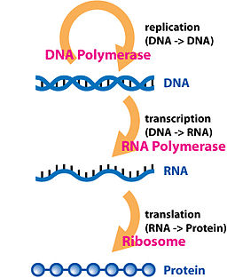
Gene Expression
Gene Expression
The synthesis of a
functional gene product
(i.e., RNA or protein).
Measuring Expression Levels of Genes (i.e., abundance of RNAs)
Microarrays and RNA-Seq.
RNA-Seq has been increasingly used because of its high reproducibility and sensitivity.
Mortazavi et al. (2008) Mapping and quantifying mammalian transcriptomes by RNA-Seq. Nature Methods 5, 621-8
Marioni et al. (2008) Rna-seq: an assessment of technical reproducibility and comparison with gene expression arrays.
Genome Res 18(9), 1509–17

Slide 5
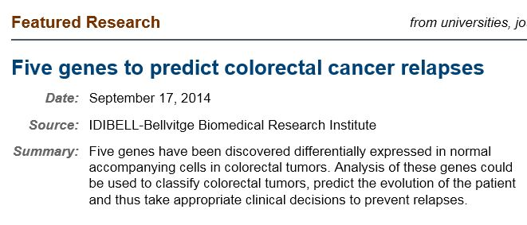
Differential Gene Expression Analysis
Differential Gene Expression Analysis
Identify genes that are expressed differently in biological samples of interest.
Importance of Differential Gene Expression Analysis
As a fundamental tool for discovering genes involved in a disease or biological process, differential gene expression analysis plays an important role in genomics research with many applications in systems biology.
Notes:
Why is differential gene expression analysis important? It is a fundamental tool for discovering genes involved in a disease or biological process

Slide 6
Differential Gene Expression Analysis
Differential Gene Expression Analysis
Identify genes that are expressed differently in biological samples of interest.
Importance of Differential Gene Expression Analysis
As a fundamental tool for discovering genes involved in a disease or biological process, differential gene expression analysis plays an important role in genomics research with many applications in systems biology.
However, disease related genes are often not among the most differentially expressed. Hence, sensitive differential expression analysis is critical.
Notes:
Why is differential gene expression analysis important? It is a fundamental tool for discovering genes involved in a disease or biological process

Slide 7
Overview of RNA-Seq Procedure
????????????
????????????
????????????????????
???????????
???????????
??????
Extract all RNA molecules
??????????
??????????
????????????????
??????????
??????
??????????
Prepare a library of
cDNA fragments
Sequence
fragments
AACGTT
CTAACG
TTAGCA ACCGAC ATGGCA
TTGTCA
CGCATG GTCACT
??????
??????
?????? ?????? ??????
??????
???? ?????
The reads may also have paired-ends.
Wang, Z. et al. (2009) RNA-Seq: a revolutionary tool for transcriptomics., Nature Revivew Genetics 10(1):57-63
Notes:
This is an overview of RNA-Seq Procedure. To measure gene expression levels, we first seqeuence all mRNA fragment in a population of cells. We extract all mRNA from the cells and then prepare a library of cDNA fragments from the mRNA. Then, we sequence all the fragments. Every sequenced fragment is called a RNA read.

Slide 8
Read Alignment and Expression Level
Gene A
Gene B
Gene C
GeneD
TTAGCA ACCGAC
ATGGCA
TTGTCA
CGCATG GTCACT
AACGTT
CTAACG
The number of reads mapped/aligned to a gene is called its read count, which is often nearly linearly correlated with the expression level of the gene.
One may also consider the expression levels of exons (exon-based analysis) or transcripts/isoforms (full transcript-based analysis) as expression features, to take into account alternative splicing.
Mortazavi, A. et al. (2008) Mapping and quantifying mammalian transcriptomes by RNA-Seq, Nature Methods 5(7)
Notes:
After sequencing all the reads, we align the reads back to the reference genome sequence. The number of reads assigned to a gene is called the read count of the gene which has been shown to be nearly linearly correlated with the expression level of a gene.

Slide 9
Problem Formulation
Sample 1
Sample 2
Gene A
Gene A
100
110
103
101
113
103
100
110
Differential gene expression analysis is to identify which genes are differently expressed (DE) or equally expressed (EE) between biological conditions of interest using observed read counts.
DEGseq, GPSeq, DESeq, edgeR, NOISeq, baySeq, etc.

Slide 10
Difficulties
Statistical power decreases when the number of reads decreases.
Sample A
Sample B
g₁
100
144
g₂
10
14
Given background noise, it may be more difficult to tell if g₂ is a DE gene.
Long or highly expressed genes are more likely to be detected as DE genes.
This selection bias against genes with low read counts may distort downstream analyses at the systems biology level.
Notes:
The existing methods have a common problem. That is, the the prediction of DE genes become less effective when the read counts decrease. Here is an example. Both gene g1 and g2 have 40% more read coutnts in sample B than in sample A. However,

Slide 11
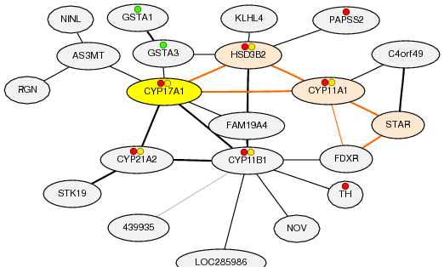
Our Method: MRFSeq
Use coexpression data to enhance the statistical prediction power.
Probabilistic modeling with a Markov random field (MRF).
DE genes
g₃
g₄
g₁
?
g₂
EE genes
g₅
Obayashi T. and Kinoshita K. (2011) COXPRESdb: a database to compare gene coexpression in seven model animals. Nucl. Acids Res.
Wei Z. and Li H. (2007) A Markov random field model for network-based analysis of genomic data. Bioinformatics 23 (12):1537-44.

Slide 12
The (Pairwise) MRF Model
x₃
x₁
x₂
x₄
The joint (a posteriori) probability distribution of x ’s (given read counts) follows the Boltzmann distribution:
i
i
The maximum a posteriori (MAP) probability can be estimated by a fast max flow algorithm.
Kolmogorov, V. and Zabih, R. (2004) What energy functions can be minimized via graph cuts? IEEE Transactions on Pattern Analysis and Machine Intelligence 26(2), 147-159.

Slide 13
12/43
RNA-Seq
read counts
Compute prior probabilities by using DESeq or other RNA-Seq based tools
Coexpression
network
Build a Markov random field (MRF)
Estimate the MAP probability by using an efficient max flow algorithm
Differentially
expressed genes
Yang EW, Girke T and Jiang T. (2013) Differential gene expression analysis using coexpression and RNA-Seq data. Bioinformatics 29.

Slide 14
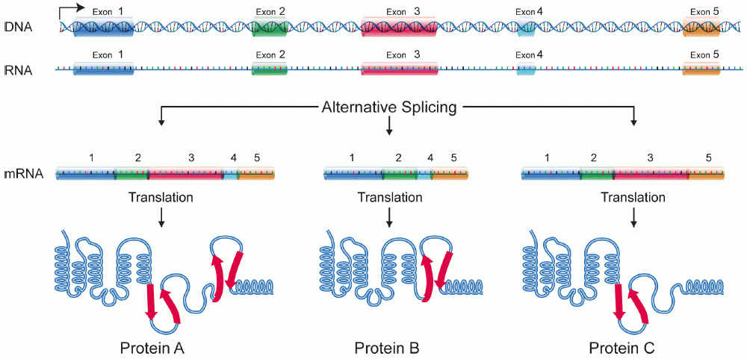
Transcript-Based Differential Expression Analysis Is More Sensitive due to Alternative Splicing
transcripts or isoforms
Wikipedia

Slide 15
Expression Features That Are Sensitive to Alternative Splicing

Slide 16
Read Alignment and Expression Features
Gene A
Gene B
Gene C
GeneD
TTAGCA ACCGAC
ATGGCA
TTGTCA
CGCATG GTCACT
AACGTT
CTAACG
The number of reads mapped to a gene is called its read count, which is often nearly linearly correlated with the expression level of the gene.
One may also consider the expression levels of exons (exon-based analysis) or transcripts/isoforms (full transcript-based analysis) as expression features, to take into account alternative splicing.
Mortazavi, A. et al. (2008) Mapping and quantifying mammalian transcriptomes by RNA-Seq. Nature Methods 5(7)
Notes:
After sequencing all the reads, we align the reads back to the reference genome sequence. The number of reads assigned to a gene is called the read count of the gene which has been shown to be nearly linearly correlated with the expression level of a gene.

Slide 17
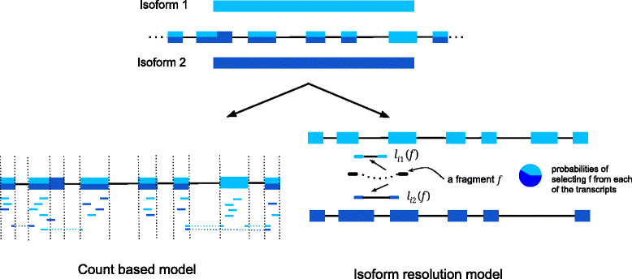
Expression Features of a Gene
Exon-based model
Full transcript-based model
Normalized numbers of reads on exons
Proportion of reads on transcripts

Slide 18
Splice Graph Based Expression Features
Proportion of reads on each path of the ASMs (alternative splicing modules)
Hu, Y. et al. (2013) Diffsplice: the genome-wide detection of differential splicing events with rna-seq. Nucleic Acids Res. 41(2), e39

Slide 19
Pros and Cons
Normalized numbers of reads on exons
Straightforward and easy to estimate correctly
Unable to provide full details of alternative splicing events (e.g., splice junctions).
Proportion of reads on full-length transcripts
A comprehensive portrait of differential transcription
Estimation of the abundance of full-length transcripts is challenging, especially when many transcripts are around. Transcripts are not always known.
Proportion of reads on ASM paths
A compromise of the above two approaches. The best of both worlds?

Slide 20
Differential Transcript Expression Analysis
Sample 1
Sample 2
Feature A
Feature A
10.0
11.0
10.3
10.1
11.3
10.3
10.0
11.0
Differential transcript expression analysis is to identify which (spliced graph based) expression features vary significantly across samples (or between conditions) using observed read counts.
Notes:
To identify whether a gene express differently between two samples of interests, we can compare the reads counts in the two samples. Here is an example, Gene A has 10% more read counts in sample 2 than in sample 1. it seems to be easy to conclude that gene A is a DE gene. However, if we repeat the experiment four times and get these read counts, is it still obvious that gene A is a DE genes?

Slide 21
Differential Expression Analysis on Population Data with Unknown Conditions (i.e., Cohort Data 队列数据)

Slide 22
Identification of Human Triple-Negative Breast Cancer Subtypes
Clustering triple negative cancer samples by their gene expression profiles gives rise to seven subtypes.
Each cluster responds differently to therapies.
Differentially expressed genes/transcripts could lead to biomarkers associated with the subtypes.
Lehmann, B.D. et al. (2011) Identification of human triple-negative breast cancer subtypes and preclinical models for selection of targeted therapies. J Clin Invest. 121(7):2750-67. doi: 10.1172/JCI45014

Slide 23
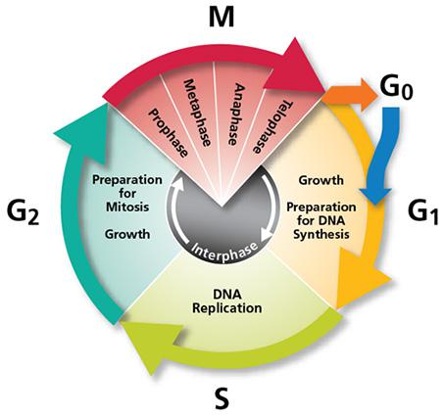
Applications in Single Cell Sequencing
Identify cell types
Identify cell-cycle phases
A.M. Streets and Y. Huang (2014) How deep is enough in single-cell RNA-seq? Nature Biotechnology 32, 1005–1006

Slide 24
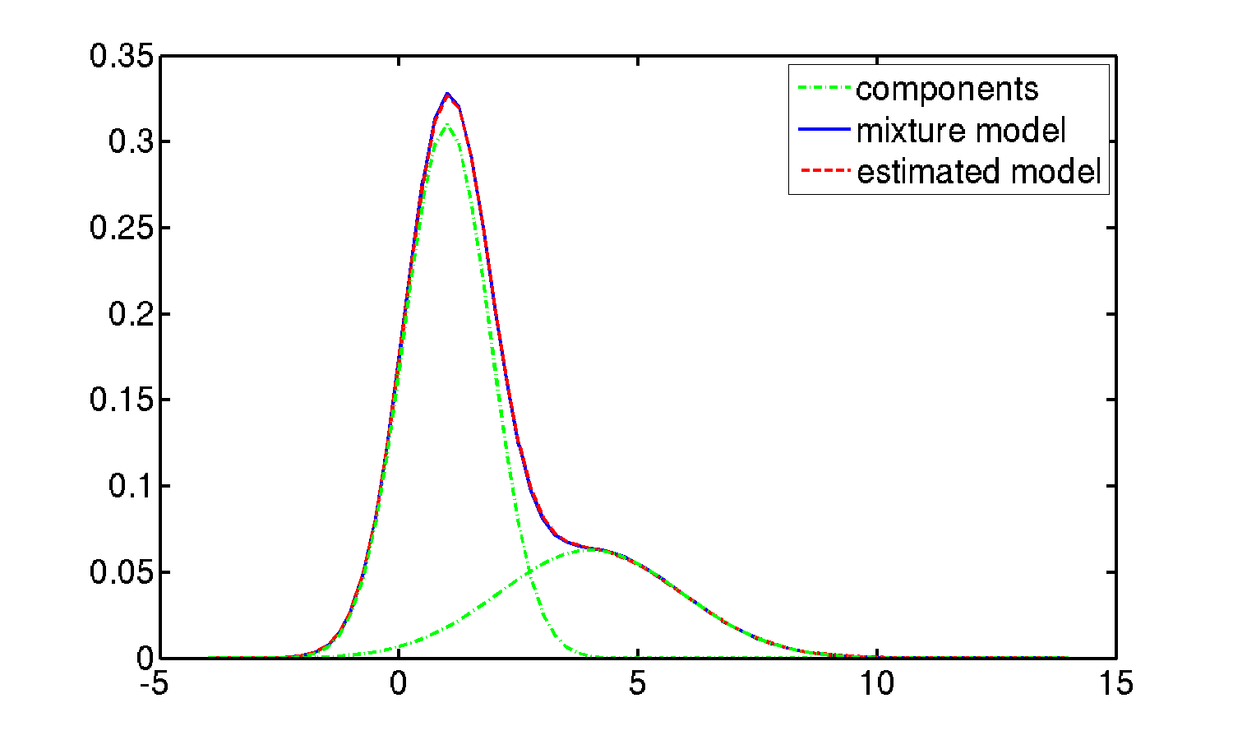
Testing Differentially Expressed Features with Unknown Conditions
To test whether an expression feature has differential expression, samples are clustered based on the values of the expression feature.
Statistical significance of clusters is tested
%
Value of expression feature
Kimes, P.K. et al. (2014) SigFuge: single gene clustering of RNA-seq reveals differential isoform usage among cancer samples. Nucleic Acids Res. 42(14), e113

Slide 25
Differential Expression Analysis on RNA-Seq Data
 | With Conditions (e.g., case-control data) | Without Conditions
Differential Gene Expression | DESeq2, edgeR, etc. | SIBER, DEXUS
Differential Transcript Expression (absolute abundance) | Alexa-Seq, Cuffdiff 2, DESeq2, edgeR, etc.
Differential Splicing (relative abundance) | Diffsplice, MATS, etc. | SigFuge
SIBER, DEXUS, SDEAP
SDEAP = genes containing DE transcripts + alternative splicing events

Slide 26
Novelty of SDEAP
Clustering
Finite mixture model (DEXUS, SIBER and SigFuge)
K is a fixed parameter (K=2 or given by user)
Dirichlet infinite mixture model (SDEAP)
K is automatically estimated
Expression Features
Normalized read counts on exons (DEXUS, SIBER and SigFuge)
Full details of alternatives splicing events are not provided
Alternative splicing modules or ASMs (SDEAP)
ASMs are more informative for downstream analyses

Slide 27
Splice Graphs (1/2)
A node v is a region of an exon delimited by two exon boundaries (also called an expressed segment or a subexon). An edge (u,v) is introduced if there is a read spanning the regions u and v.
Hu, Y. et al. (2013) Diffsplice: the genome-wide detection of differential splicing events with rna-seq. Nucleic Acids Res. 41(2), e39

Slide 28
Splice Graphs (2/2)
Mapped reads
Reads on an expressed segment
Reads spanning two expressed segments

Slide 29
Alternative Splicing Modules
Graph modular decomposition:
Alternative splicing modules (ASMs):
v_{s}
v_{t}
ASM H(V_{H},v_{s},v_{t})
V_{H}
A new algorithm for enumerating all ASMs is given in this work, correcting an error in Hu et al. (2013).

Slide 30
Expression Features from Splice Graphs
T1=1 T2=2 T3=3 T4=4
Average number of
reads on each path of the ASMs
[ 7, 3, 6, 4 ]
FPKM =

Slide 31
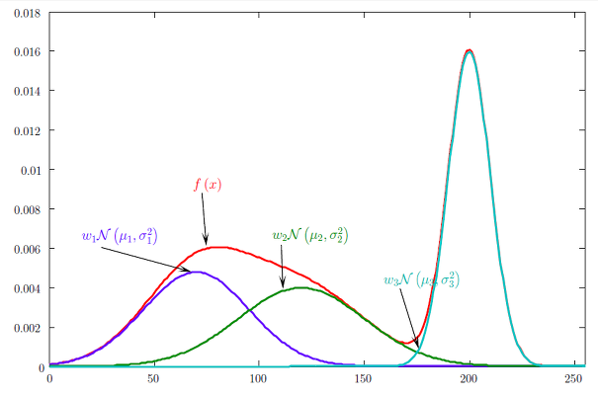
Clustering
Estimating the correct number of clusters is challenging for a routine user.
Finite mixture model (DEXUS and SigFuge)
K is a fixed parameter (K=2 or given by user)
Dirichlet infinite mixture model (SDEAP)
K is automatically estimated
Testing the statistical significance of clusters
1.0, 2.7, …. , 1.0, …
1.2, 2.3, …. , 0.8 , …
0.9, 3.0, …. , 1.4 , …
N samples
without conditions
…..
1.2, 3.1, …. , 3.2, ...
1.3, 2.9, …. , 4.8 , …
1.4, 3.1, …. , 3.4 , …
M features

Slide 32
Bayesian Mixture Model
P(C| )
P( |C)
P(C)
Posterior
Likelihood
Prior
C
= model
= observations / expression features
P( |C)
= Gaussian ( | θ_{c})

Slide 33
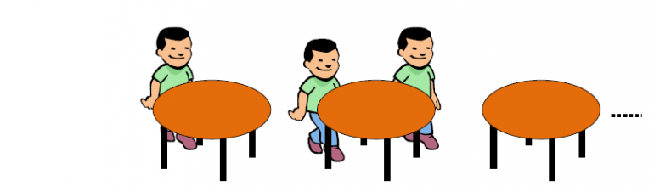
The Prior Probability
P(C)
Chinese Restaurant Process
The n instances of a feature are like n customers in a Chinese restaurant ……..
For every costumer i,
the probability that the costumer i sits at table j is
the probability that the costumer i sits at a new table is

Slide 34
Background Noise Estimation
True DE features
CV²
(σ² /μ²)
CV²=a+b(1/ μ)
Mean (μ)

Slide 35
Experimental Results

Slide 36
Simulation Experiments (Standard RNA-Seq)
Simulating standard RNA-Seq data using hg38 human reference genome sequences
The numbers of reads mapped to transcripts from the same condition follow a negative binomial distribution
Assessment metrics
PRE: precision
REC: recall (sensitivity)
AUC_{pr}: the area under precision-recall curve
More sensitive for imbalanced data
Multiple conditions
Two conditions
Three or more conditions

Slide 37
Simulated Data from Two Conditions
SDEAP achieves better accuracy scores on data from binary conditions
3091 genes with FPKM values > 1.0
10 % genes have DE transcripts
5% genes contain outlier expression features across input samples

Slide 38
Simulated Data from Three or More Conditions
SDEAP outperforms DEXUS on data from 3 or more conditions
3 conditions : (1,4) ( 1, 4, 2.5)
5 conditions : ( 1, 4, 2.5) ( 1, 4, 2.5, 1.75, 3.25)

Slide 39
Simulation Experiments (Single Cell RNA-Seq)
Due to low volume of transcripts in an individual cell, the expression of transcripts may fail to be detected in some replicates (dropout events)
Single cell RNA-Seq data have high dispersion rates
Very noisy data

Slide 40
With or Without Known Conditions
When the data are not highly imbalanced, there is no noticeable difference between the prediction accuracy of SDEAP, DESeq2, Cuffdiff 2, and edgeR.

Slide 41
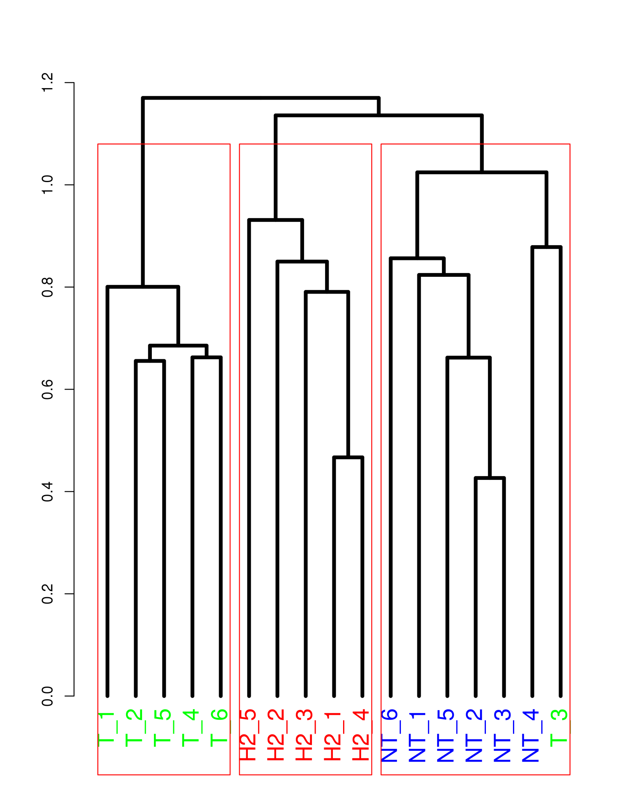
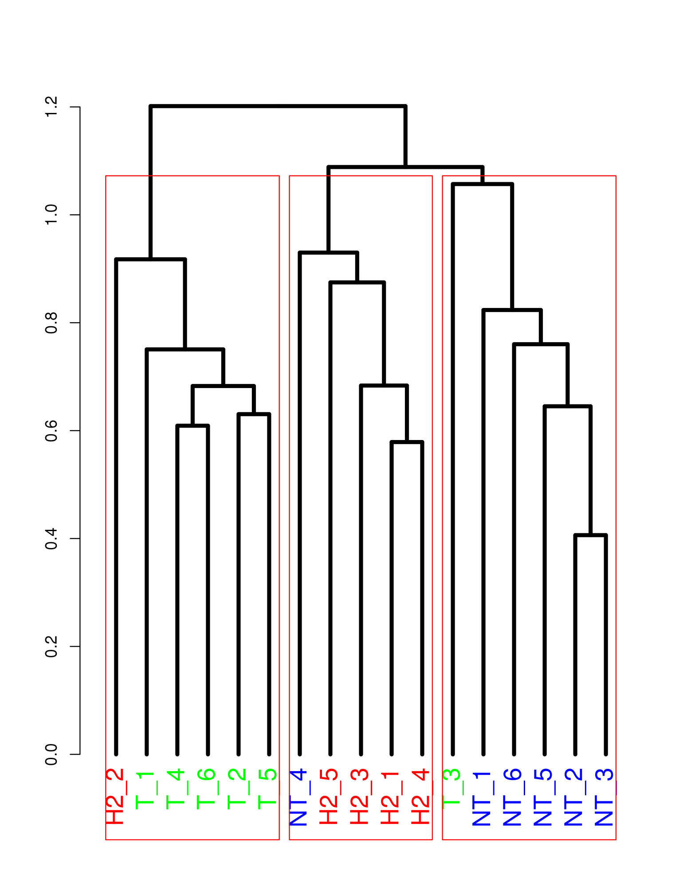
Separating Cancer Subtypes
SDEAP detects cancer subtypes more accurately:
17 standard RNA-Seq samples from 3 subtypes of breast cancer: HER2, TNBC and Non-TNBC
SDEAP
DEXUS
J=0.760
J=0.481
Eswaran, J. et al. (2012) Transcriptomic landscape of breast cancers through mRNA sequencing. Scientific Reports 2, 264

Slide 42
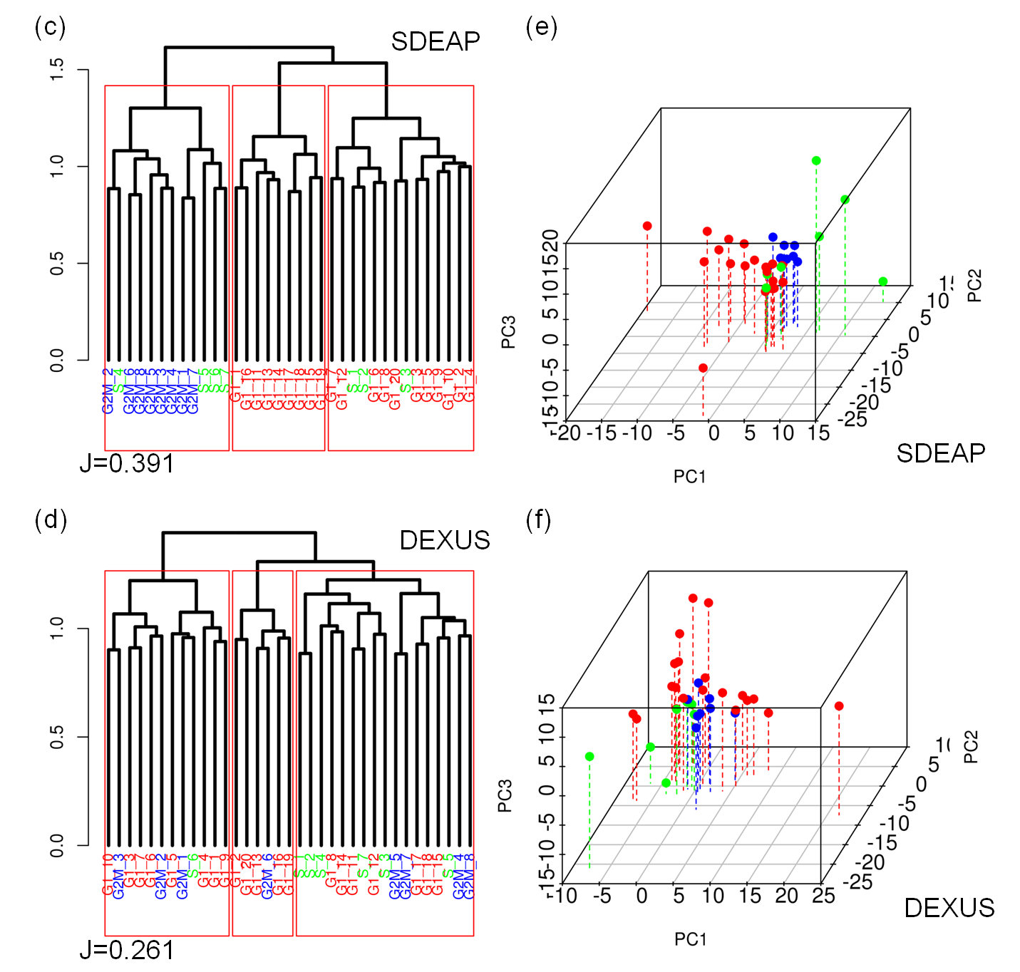
Classifying Cell-Cycle Phases (on scRNA-Seq)
SDEAP is better at separating cell-cycle phases:
35 mouse embryonic stem (ES) cells in 3 cell-cycle phases
Sasagawa, Y. et. al. (2014) Quartz-Seq: a highly reproducible and sensitive single-cell RNA sequencing method, reveals nongenetic gene-expression heterogeneity, Genome Biology

Slide 43
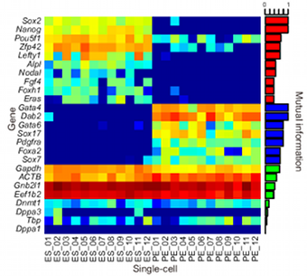
Comparison with Known Biomarkers
SDEAP identifies more validated marker genes specific to cell types:
12 mouse embryonic stem (ES) cells and 12 primitive endoderm (PrE) cells
20 cell type specific markers have previously been manually selected based on mutual information
SDEAP discovered all 20 markers when DEXUS was able to get 16
8 PCR validated DE genes
SDEAP predicted all of the
8 validated markers while
DEXUS missed 2
Sasagawa, Y. et. al. (2014) Quartz-Seq: a highly reproducible and sensitive single-cell RNA sequencing method, reveals nongenetic gene-expression heterogeneity, Genome Biology
,

Slide 44
CONCLUSION
MRFSeq
RNA-Seq data with coexpression data combined
Efficient MAP estimation based on max-flow
Reduced selection biases against genes with low read counts
http://www.cs.ucr.edu/~yyang027/mrfseq.htm
SDEAP
Expression features based on alternative splicing modules (ASMs)
Accurate graph modular decomposition algorithm for enumerating all ASMs
Robust clustering model capable of inferring the number of conditions in a population
https://github.com/ewyang089/SDEAP/wiki

