Slide 1
Science of Information:
Case Studies in DNA and RNA assembly
David Tse
Stanford University
MIIS Workshop
December 18, 2016
Research supported by the NSF Center of Science of Information.
TexPoint fonts used in EMF: AAAAAAAAAAAAAAAA

Slide 2
History
In 1948, Claude Shannon invented a mathematical theory of communication.
70 years later, all communication systems are designed based on the principles of information theory.

Slide 3
Information and computation
Shannon looked at information limits without computational consideration.
Yet, 70 years of intense research ultimately reveals computationallly efficient coding schemes achieving these limits.

Slide 4
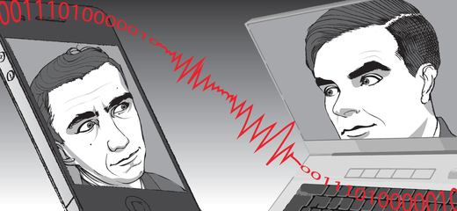
Information before computation
C.E. Shannon
A.M. Turing
What is the information limit for communication?
But optimal decoding of general codes is NP-hard!
I only care about problem instances that matter.

Slide 5
Beyond communication
Can information be used as a guiding design principle for other problems?

Slide 6
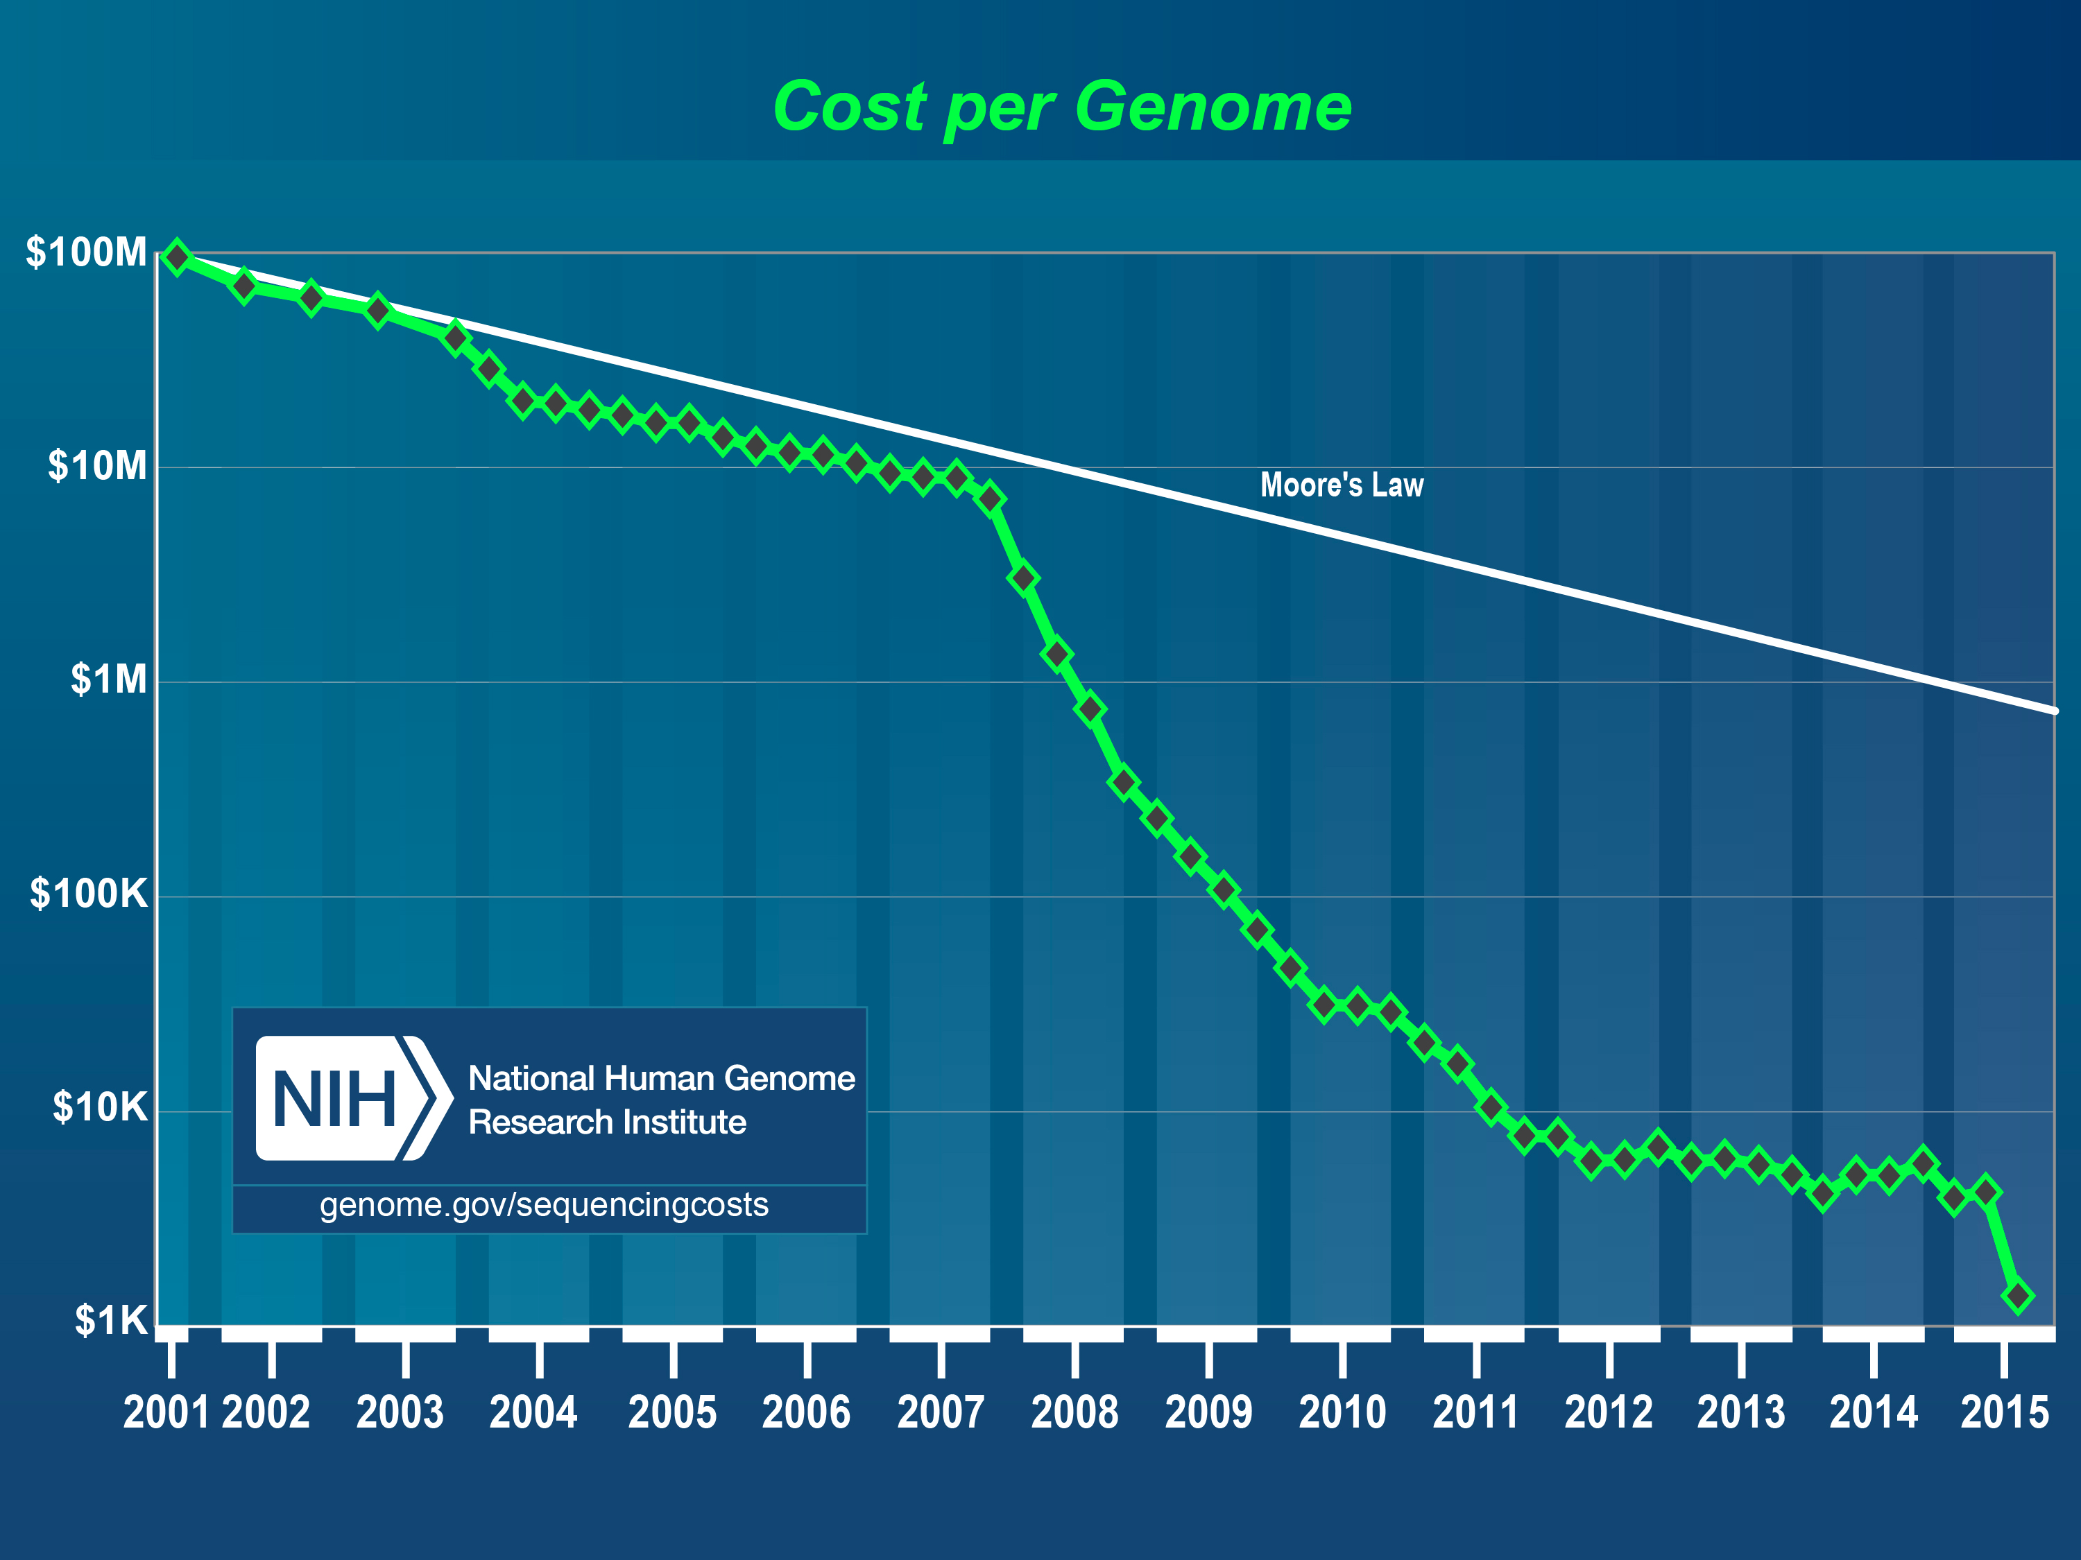
High throughput sequencing revolution
Sequencing = Biochemistry + Computation
Notes:
Faster than Moore;s Law
Implication to the IT community

Slide 7
DNA Assembly Problem
N randomly located reads
of length L
Shotgun Sequencer
Assembler
T C G C G
A T T C G
A C G C A T T C G C G A T T
C G C A T
C G A T T
G C G A T
T T C G C
C A T T C
A C G C A
A C G C A T T C G C G A T T
G = 10⁶ to 10¹⁰
N = 10⁷ to 10⁹
L= 10² to 10⁴
Notes:
Add errors?
Mention de novo?
In this talk, I want to contrast to aspects of this question. The computational aspect, and the informational aspect

Slide 8
Theory for assembly
Information
Computation
How much data is required for unambiguous reconstruction?
Can answering thus question help “avoid” NP-hardness?
Formulate assembly as a combinatorial optimization problem.
  e.g., Shortest Common Superstring
Typically NP-hard
Heuristics
Notes:
If you want to talk about computational complexity, you first need a mathematical formulation of this problem
It makes sense to develop algorithms aiming perfect assembly
I won’t be arguing that one approach is better than the other, but that they can provide different perspectives when developing algorithms
Erase things at the end. Show outline on the right, with what will actually be shown?

Slide 9

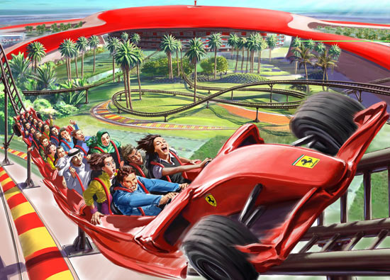
Key challenge: repeats
harder jigsaw puzzle
easier jigsaw puzzle
How exactly do the information limits depend on repeats?

Slide 10
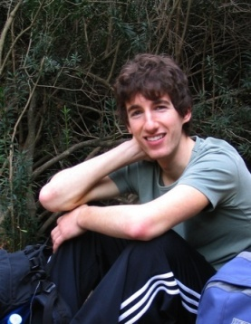
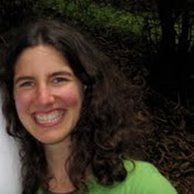
Data-driven information limit
Bresler, Bresler & T.
BMC Bioinformatics 13
# of repeats
information lower bound
repeat
length
Human Chr 19
Build 37
Lander-Waterman coverage
Notes:
Start with individual sequence, extract sufficient statistics, get curves

Slide 11

Lower bound: interleaved repeats
Necessary condition:
all interleaved repeats are bridged.

Slide 12
Lower bound: triple repeats
Necessary condition:
all triple repeats are bridged

Slide 13
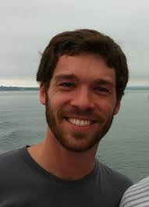
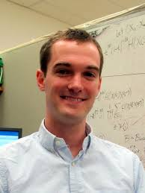
Approaching the limit
Shomorony, Courtade & T.
Bioinformatics, 2016
Read-overlap graph
Sequence is a path that visits every node.
  (Generalized) Hamiltonian Path
  Finding optimal GHP is NP-hard
2
ACGCA
4
CGCAT
1
TCGCG
ACGCATTCGCG
3
2
3
2
CATTC
4
ATTCG

Slide 14
Approaching the limit
Read-overlap graph
Sequence is a path that visits every node
  (Generalized) Hamiltonian Path
  Finding shortest GHP is NP-hard

Slide 15
How well does a greedy algorithm do?
  For each node, pick edge with best overlap
3
4
N
N_{LW}
1
5
5
6
1
1
6
3
3
1
?
Greedy
4
2
5
1
3
2
7
5
1
4
3
1
_{repeat}(s)
L
7
Generalized
Hamiltonian path
  What if there are long repeats?
Greedy approach fails.
Notes:
Greedy on title?
We will do this sparsification/pruning based on insights from the information limits
It turns out

Slide 16

Insights from Information limit
  True path may need to visit a node more than once
3
4
N
N_{LW}
1
5
5
6
1
1
6
3
3
1
$$(N,L)$$
4
2
5
1
3
2
7
5
1
4
3
1
L
7
Generalized
Hamiltonian path
Notes:
Greedy on title?
We will do this sparsification/pruning based on insights from the information limits
It turns out

Slide 17
Insights from information limit
  Can true path visit a node > 2 times?
3
4
N
N_{LW}
1
5
5
6
1
1
6
3
3
1
$$(N,L)$$
4
2
5
1
3
2
7
5
4
3
1
L
7

Slide 18
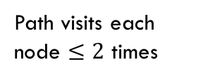
Insights from information limit
  Can true path visit a node > 2 times?
  Path visits each node $≤2$ times
3
4
N
N_{LW}
1
5
5
6
1
1
6
3
3
1
$$(N,L)$$
4
2
5
1
3
2
7
5
4
3
1
L
7
  Two paths are indistinguishable!

Slide 19
Not-so-greedy algorithm
Keep only the 2 best extensions at each node.
Further pruning removes spurious edges.
Results in a sparse read-overlap graph.

Slide 20
Not-so-greedy: performance guarantee
Theorem 1:
If all triple repeats are all bridged, then no spurious and no missing edges in sparse graph.
i.e. genome is an Eulerian path in the graph.
Theorem 2:
If furthermore all interleaved repeats are bridged, then unique Eulerian path.

Slide 21
Not-so-greedy: near optimality for Chr 19
greedy
lower bound
length
Not-SO-GREEDY
Human Chr 19
Build 37
Lander-Waterman coverage
Notes:
4. Multibridging is the algorithm we propose, which is nearly optimal, at least for chromosome 19. Did we get lucky?

Slide 22
GAGE Benchmark Datasets
http://gage.cbcb.umd.edu/
Rhodobacter sphaeroides
Staphylococcus aureus
Human Chromosome14
G = 4,603,060
G = 2,903,081
G = 88,289,540
lower bound
NOT-SO-GREEDY
lower bound
NOT-SO-GREEDY
lower bound
NOT-SO-GREEDY
Notes:
What about the lower bound?

Slide 23
From NP-hard to linear time
NP-hard
Linear time
read-overlap graph:
Hamiltonian
sparse
read-overlap graph:
Eulerian
N
N_{LW}
$$(N,L)$$
L

Slide 24

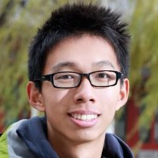
Long-read assembler: HINGE
Kamath et al 2016
Genome Research, under review
  github.com/fxia22/HINGE
  Evaluation: Pacific Biosciences data on bacterial genomes (NCTC dataset)
Total | 688
HINGE finished assemblies | 583
HGAP (Chin et al, 2013) | 517
Miniasm (Li, 2015) | 513
Notes:
Cross section, designing algorithms according to this

Slide 25
From DNA to RNA
DNA
GGCTTACC
AGTTG
TCGAGTTC
GGAAT
TATCATTTT
ACACAA
AAGTAAA
Exon
Intron
1000’s to 10,000’s symbols long
GGCTTACC
TATCATTTT
AAGTAAA
TCGAGTTC
AAGTAAA
RNA Transcript 1
RNA Transcript 2
Alternatively spliced isoforms.

Slide 26
RNA-Seq assembly
Transciptome
Reads
GGCTTACC
TATCATTTT
AAGTAAA
CGAGT
GGCTTACC
TATCATTTT
AAGTAAA
TCGAGTTC
AAGTAAA
TCAAG
Assembler reconstructs
transcriptome
TCGAGTTC
AAGTAAA
TCGAGTTC
AAGTAAA
AGTAA
L=5

Slide 27
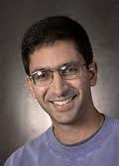

RNA assembler: Shannon
Kannan, Pachter & T.
Nature Biotech, under review
http://sreeramkannan.github.io/Shannon
Evaluations:
135M Illumina L = 50 reads from human embryonic stem cells. (Au et al, PNAS 2013)
110 million Illumina L= 101 paired end reads from the Lymphoblastoid cells in the GM12878 cell line.
(Tilgner et al, PNAS 2014)

Slide 28





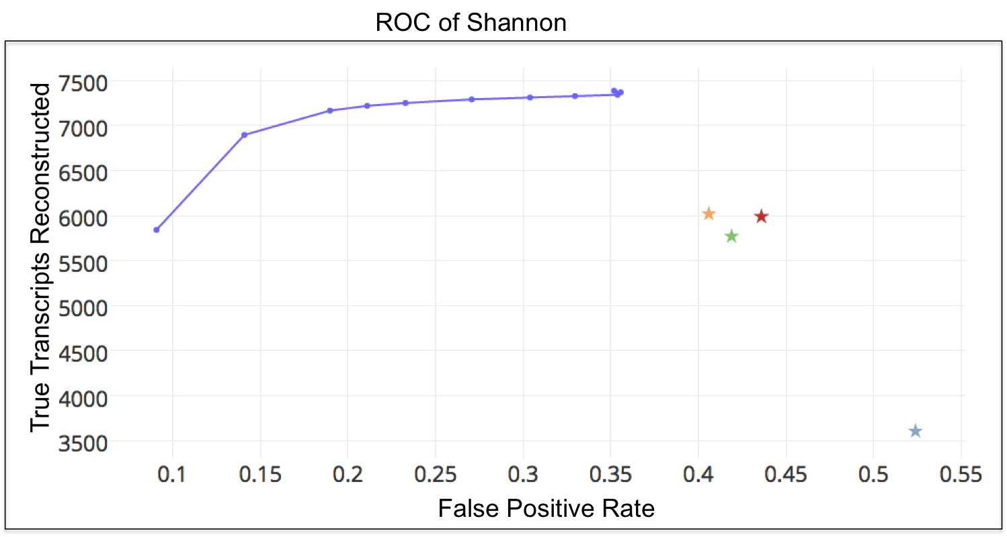
Human embryonic stem cells dataset

Slide 29
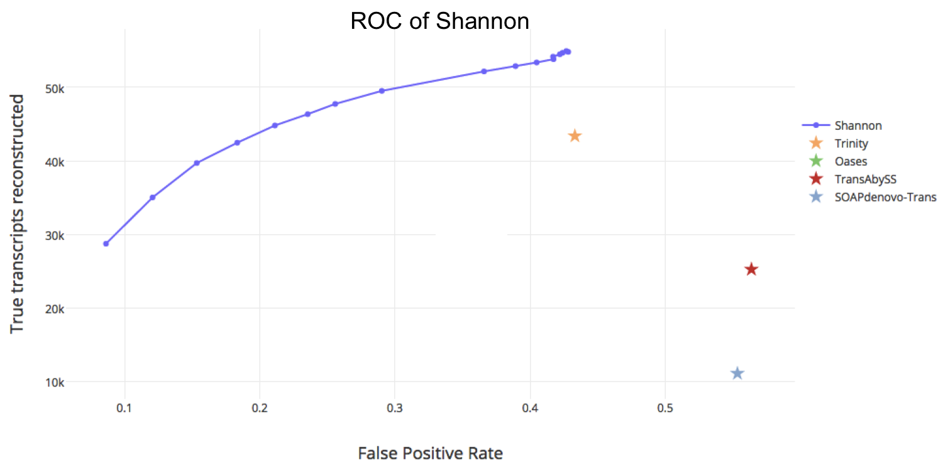
Lymphoblastoid dataset

Slide 30
Conclusion
Information theory is about fundamental limits.
It is a constructive theory.
It overcomes computationally intractable problems by focusing on tractable instances.

